Slide 1

Mobile Genetic Elements in Freshwater Environments
Sophia Aredas
Schmidt Lab

Slide 2

POV: You are a scientist
What does this make you think of?

Slide 3

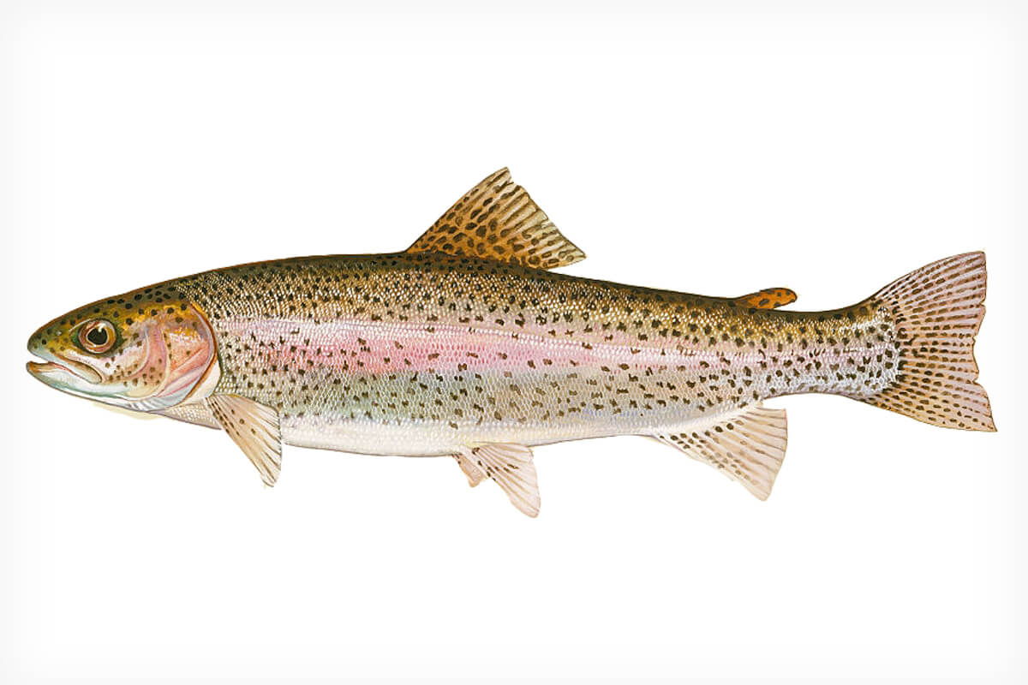
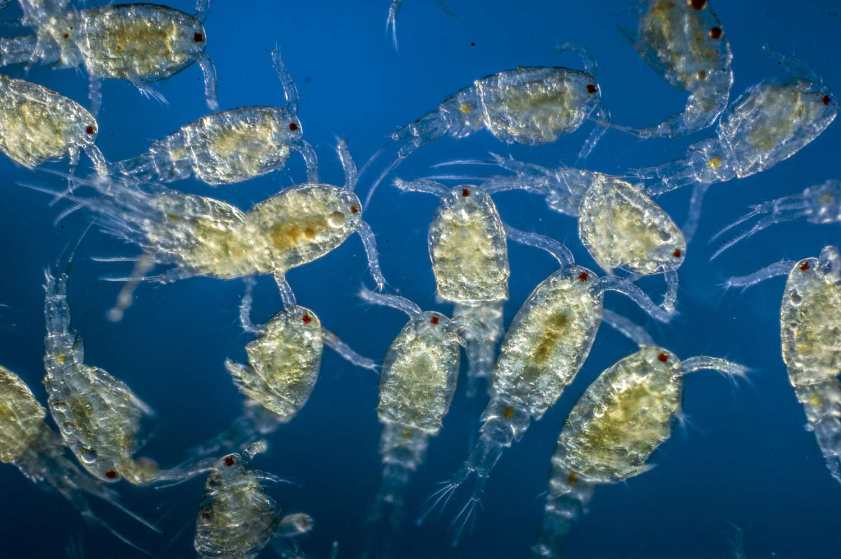
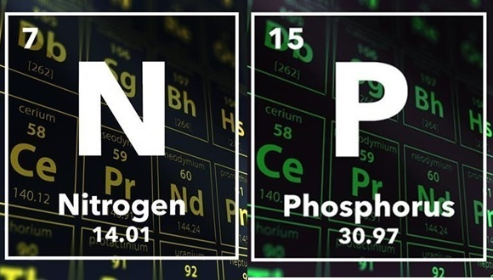

Slide 4
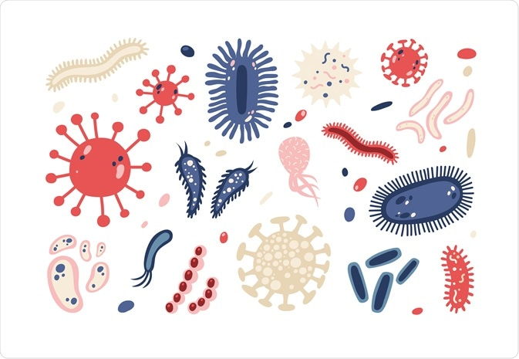
Microbial Communities

Slide 5

But how do microbes interact within a community?

Slide 6
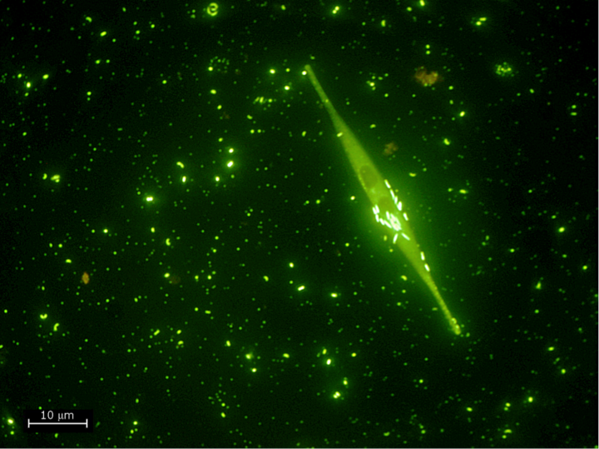
In freshwater ecosystems, bacteria can be categorized by their lifestyle
Dila & Biddanda, Eos (Feb 2019)
Notes:
Add the citation for picture

Slide 7
In freshwater ecosystems, bacteria can be categorized by their lifestyle
Particle associated
Dila & Biddanda, Eos (Feb 2019)

Slide 8
In freshwater ecosystems, bacteria can be categorized by their lifestyle
Particle associated
Free-living
Dila & Biddanda, Eos (Feb 2019)

Slide 9
In freshwater ecosystems, bacteria can be categorized by their lifestyle
Particle associated
Free-living
Generalists
Dila & Biddanda, Eos (Feb 2019)

Slide 10
In freshwater ecosystems, bacteria can be categorized by their lifestyle
Particle associated
Free-living
Generalists (microbes found in both free-living and particle associated)
Dila & Biddanda, Eos (Feb 2019)

Slide 11
Bacteriophages are abundant in freshwater ecosystems
Bacteriophages
&
Outer membrane vesicles
Particle associated
Free-living
Generalists (microbes found in both free-living and particle associated)
Dila & Biddanda, Eos (Feb 2019)

Slide 12


Pelagic Bacterial Lifestyles
Free-Living
Particle-Associated

Slide 13
Pelagic Bacterial Lifestyles
Free-Living
Spend their whole life cycle as individual cells
Do not have diverse metabolic capabilities
Smaller genomes
Particle – Associated
Colonize particulate organic matter
Have diverse metabolic capabilities
More active
Larger genomes
Notes:
Interesting that free living bacteria are often more abundant than paticle attached bacteria in oceans and freshwater

Slide 14
Pelagic Bacterial Lifestyles
Free-Living (FL)
Spend their whole life cycle as individual cells
Do not have diverse metabolic capabilities
Smaller genomes
Particle – Associated (PA)
Colonize particulate organic matter
Have diverse metabolic capabilities
More active
Larger genomes
Generalists
Bacteria that alternate between FL and PA
Notes:
Interesting that free living bacteria are often more abundant than paticle attached bacteria in oceans and freshwater

Slide 15
What are some ways to enhance our fitness as a microbe?

Slide 16
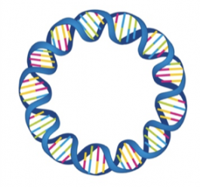
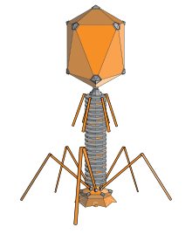
Mobile Genetic Elements
Mobile genetic elements (MGEs) are capable of mobility within or between genomes
MGEs are ubiquitous and are found in all of Earth’s ecosystems, including freshwater sources
MGEs such as plasmids and bacteriophages drive fast evolutionary and ecological changes in microbial communities
Plasmid
Bacteriophage

Slide 17
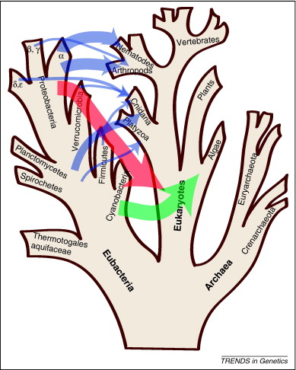
Horizontal Gene Transfer
Genetic material is transferred from a donor to any recipient cell outside of cell division
Seen in all domains of life
3 main types
Conjugation
Transduction
Transformation

Slide 18
Horizontal Gene Transfer (HGT) Conjugation
Bacterial conjugation is the transfer of plasmids between bacterial cells by direct cell-to-cell contact between two cells
Plasmids are transferred from a donor to a recipient bacterium
Vertical Gene Transfer
Genetic material is transferred from mother to daughter cells during division

Slide 19
Horizontal Gene Transfer (HGT) Conjugation
Bacterial conjugation is the transfer of plasmids between bacterial cells by direct cell-to-cell contact between two cells
Plasmids are transferred from a donor to a recipient bacterium
Vertical Gene Transfer
Genetic material is transferred from mother to daughter cells during division

Slide 20
Horizontal Gene Transfer (HGT) Conjugation
Plasmids are transferred from a donor to a recipient bacterium
Vertical Gene Transfer
Genetic material is transferred from mother to daughter cells during division
Conjugation

Slide 21
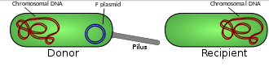
Plasmids as MGEs
Plasmids are small, circular, extrachromosomal DNA molecules
Plasmids replicate independently from the chromosome
Plasmids can offer hosts benefits such as antimicrobial resistance genes, virulence genes, heavy metal tolerance, etc.
But they also are an energetic burden on the host cell to replicate

Slide 22


Self Transmissible Plasmids
Mobilizable Plasmids

Slide 23
Self-Transmissible Plasmids
Mobilizable Plasmids
Capable of moving themselves with their own machinery
Encode genes such as tra, trb, and vir
~ 0.1% of bacteria are capable of conjugation
Energetically taxing
Phages can sense conjugation and kill them
Hitchhike using the self-transmissible plasmid machinery
Encode MOB genes

Slide 24
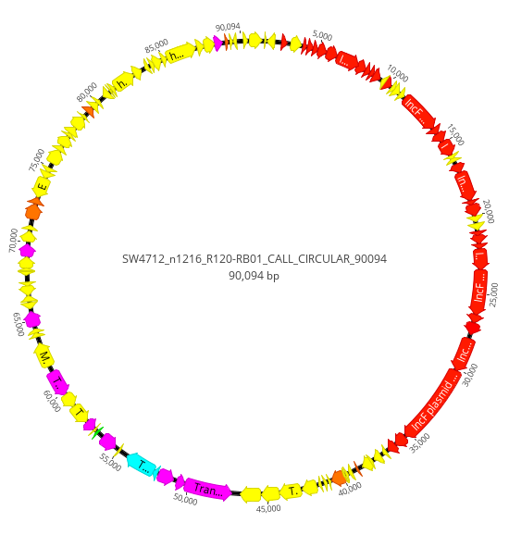
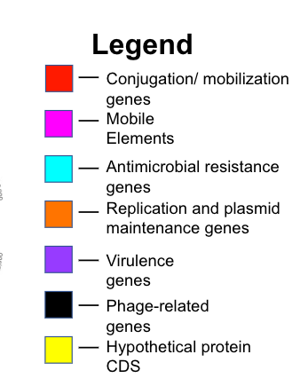
An Example of a Plasmid

Slide 25
Bacteriophages (Phages) as MGEs
Phages naturally hunt bacteria and control bacterial populations
May be composed of DNA or RNA
Host range depends on what types of bacteria a phage can infect

Slide 26
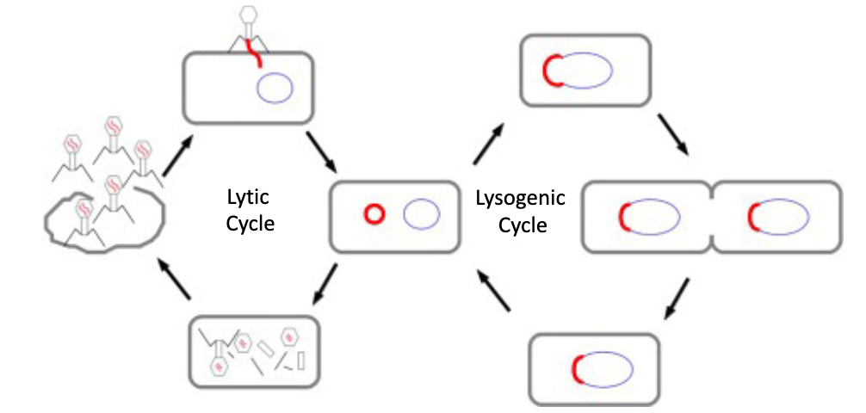
Phage Life Cycle

Slide 27
Lytic Phages
Phages infect cell by integrating its DNA, replicate, and lyse cells to release virions
All phages are capable of lytic cycle

Slide 28

Lytic Phages
COVID-19
Phages infect cell by integrating its DNA, replicate, and lyse cells to release virions
All phages are capable of lytic cycle

Slide 29
Lysogenic/ Temperate Phages
Phages infect cells with its DNA and phage DNA is integrated into bacterial DNA
This is called prophage/ provirus
But the bacterial cell does not die and is able to reproduce with the dormant prophage
Can switch to lytic cycle eventually
Non-virulent infection
Not all phages are capable of lysogeny

Slide 30
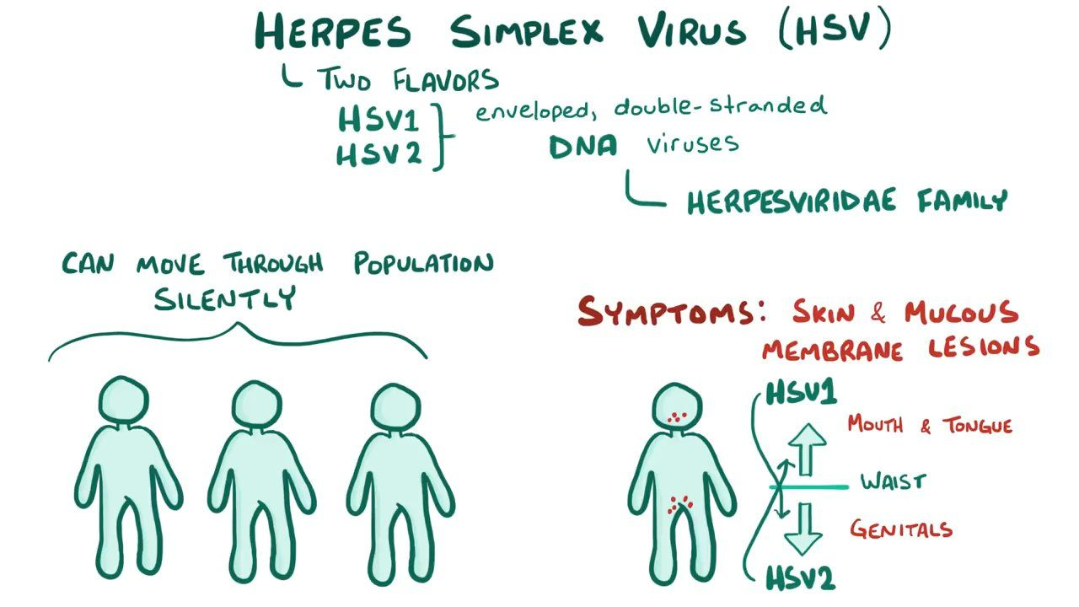
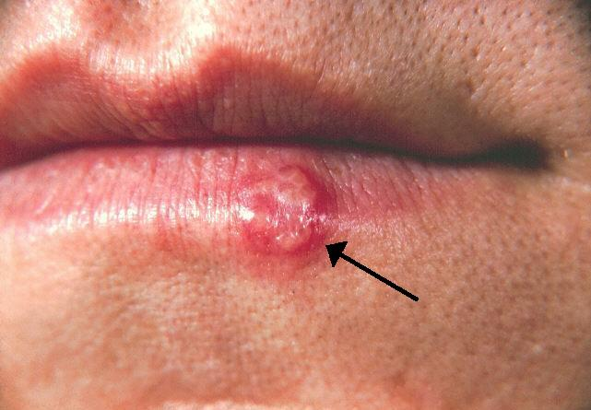
Lysogenic/ Temperate Phages
Phages infect cells with its DNA and phage DNA is integrated into bacterial DNA
This is called prophage/ provirus
But the bacterial cell does not die and is able to reproduce with the dormant prophage
Can switch to lytic cycle eventually
Non-virulent infection
Not all phages are capable of lysogeny

Slide 31

Why are phages cool?
To combat antibiotic resistance, phages are used to control bacterial populations that only target bacteria

Slide 32
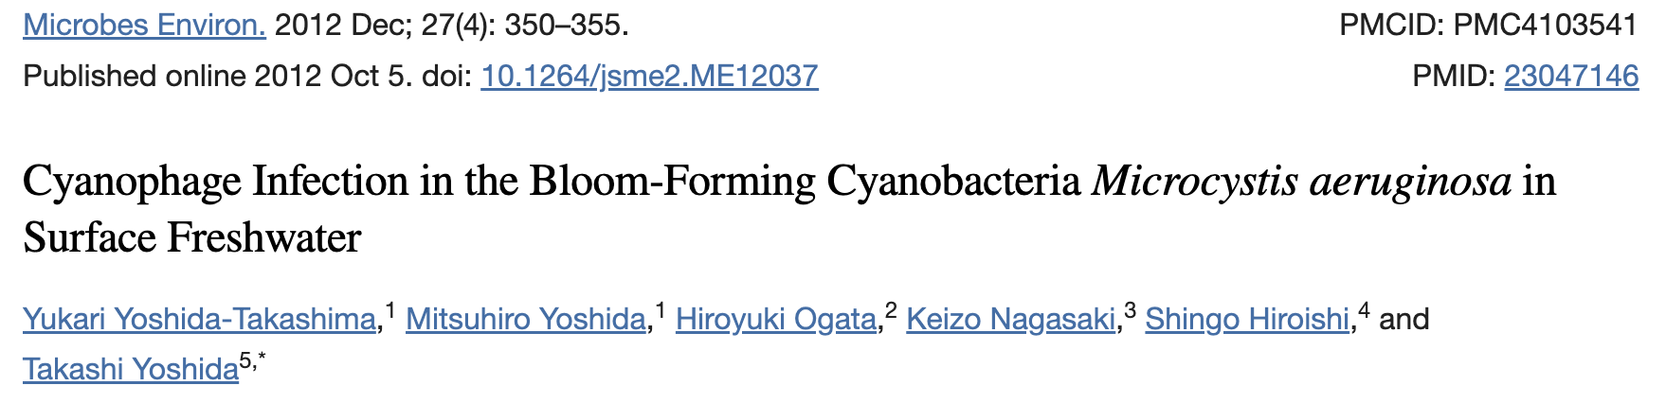
Why are phages cool?
Microcystis phage ”stole” a gene that prevents photoinhibition during infection which benefits phage

Slide 33
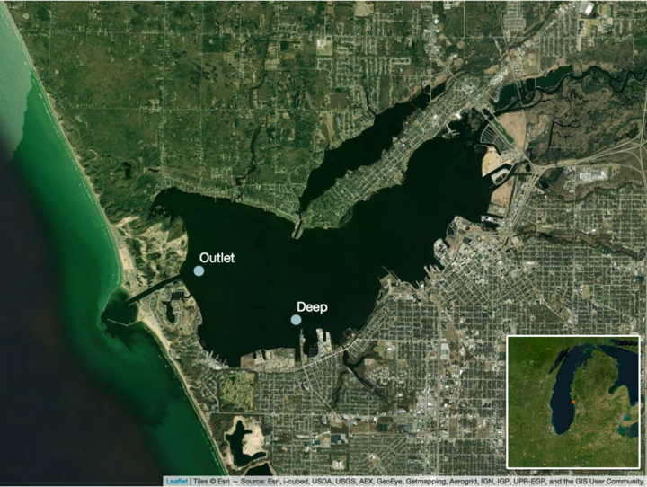
Muskegon Lake, Michigan
Drowned river-mouth that directly connects to Lake Michigan
Sampled over two years (2014-2015)
Fall
Summer
16 total samples from 2 stations
Outlet
Deep
Schmidt, et al. (2020) FEMS Microbial Ecology
Notes:
outlet and deep are the most similar because of communities

Slide 34
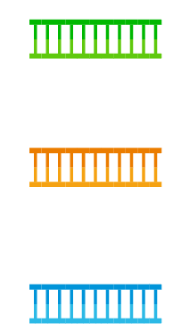



Metagenomics
Contigs
DNA Extraction +
Sequence Reads
Assemble into contigs
Sample
Binning
Metagenome Assembled Genome = MAG
Allows us to reconstruct complex and unknown genomes

Slide 35
geNomad
geNomad is a bioinformatic tool that identifies plasmids and viruses in metagenomic sequencing data
Uses a hybrid approach
Alignment-free models to classify reads from nucleotide sequences
Gene-based classification searches online databases to identify marker proteins to identify the sequence
Hybrid approach bolsters the strength of each classification method

Slide 36
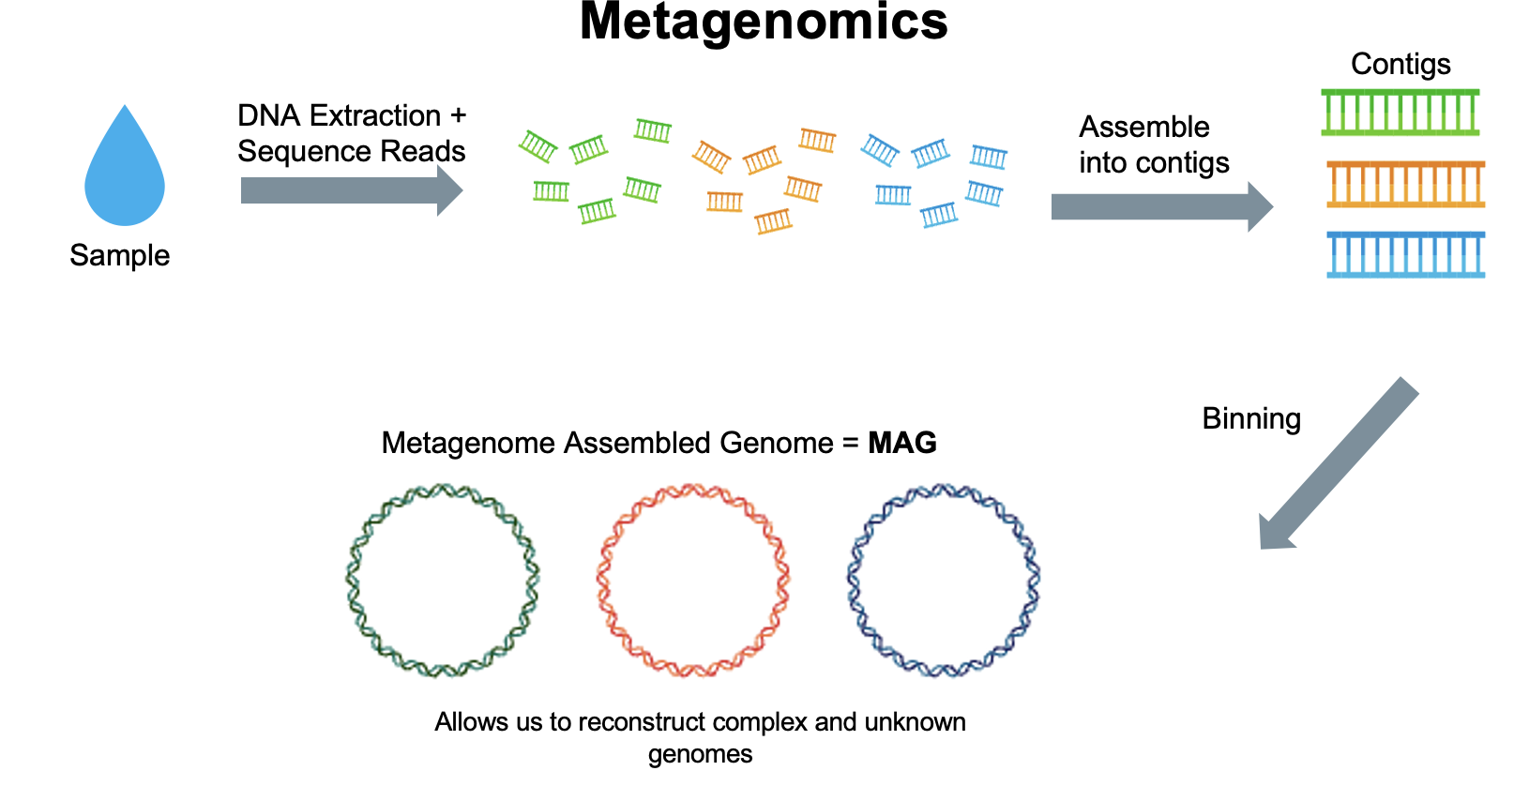
Assembly Level View
Contigs

Slide 37
Is there a difference in plasmid-encoded gene abundance between free-living and particle-attached filters? Hypothesis: There are more plasmid-encoded genes in the particle-attached filter because of the cell-to-cell contact

Slide 38
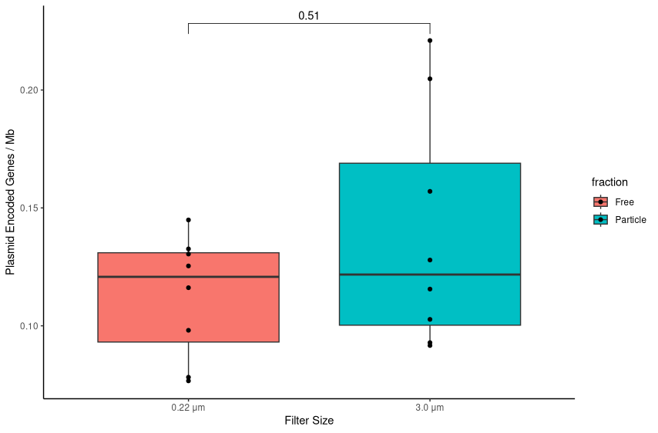
How does the number of plasmid-encoded genes vary per filter size?

Slide 39
How does the number of plasmid-encoded genes vary per filter size?
There is no significant difference between the number of plasmid-encoded genes between filter size

Slide 40
Is there a difference in conjugation gene abundance between free-living and particle-attached filter sizes? Hypothesis: There are more conjugation genes on particle-attached filter because of the cell-to-cell contact

Slide 41
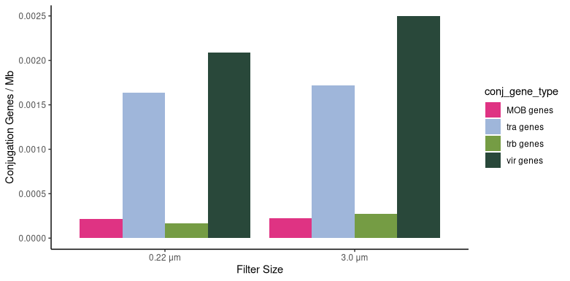
How do conjugation genes vary between filter size?

Slide 42
How do conjugation genes vary between filter size?
All conjugation genes are found in nearly equal amounts in both filter sizes

Slide 43
Is there a difference in phage-encoded gene abundance between free-living and particle-attached filters? Hypothesis: There are more phage-encoded genes in particle-attached filters because of the cell-to-cell contact

Slide 44
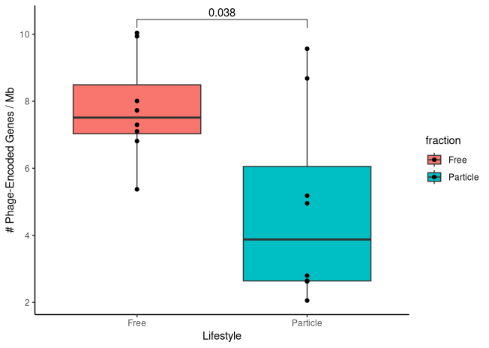
How does the number of phage-encoded genes vary per filter size?

Slide 45
How does the number of phage-encoded genes vary per filter size?
There is a significant difference in the number of phage-encoded between filter sizes

Slide 46
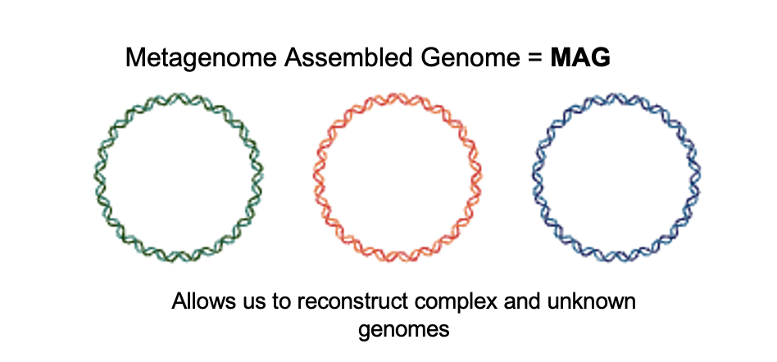
MAG Level View

Slide 47
MAG Level Analysis
MAGs were identified through statistical modeling in these 2 filter sizes and by calculating differential abundance
346 MAGs were created
Statistically significant bins were either categorized as free-living or particle-associated
Those not statistically significant were considered to be generalists

Slide 48
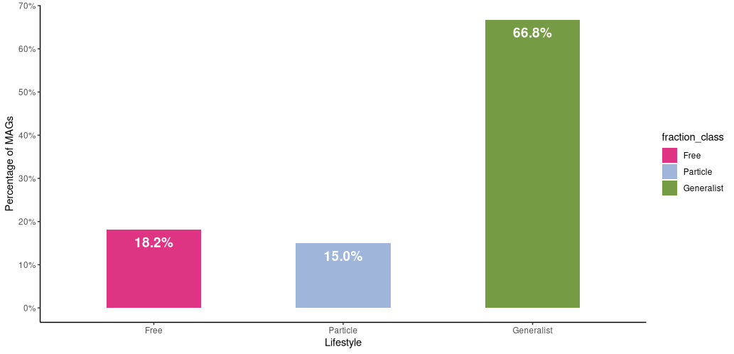
Of our 346 MAGs, what lifestyles are the MAGs in?

Slide 49
Of our 346 MAGs, what lifestyles are the MAGs in?

Slide 50
Is there a difference in plasmid-encoded gene abundance between lifestyles? Hypothesis: There are more plasmid-encoded genes in particle-attached or generalist lifestyles than free-living due to cell-to-cell contact.
Notes:
bc cell to cell contact
lay out hypotehsis more clearly
then we culd say the opposite was found

Slide 51
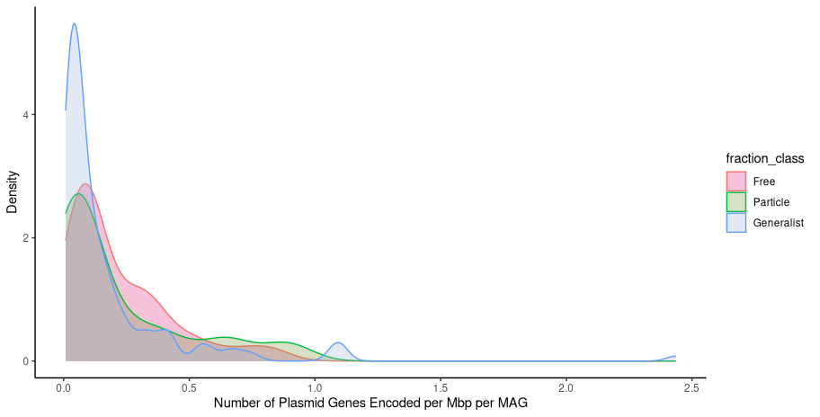
How does bacterial lifestyle impact the number of plasmid-encoded genes?
Notes:
While there are relatively similar distributions of plasmid-encoded genes across MAGs, free-living microbes do have a different distribution, which was unexpected!!

Slide 52
How does bacterial lifestyle impact the number of plasmid-encoded genes?
Free-Living bacteria have greater densities a
Notes:
While there are relatively similar distributions of plasmid-encoded genes across MAGs, free-living microbes do have a different distribution, which was unexpected!!
Density plot is a variation of a histogram that visualizes the distribution of non-parametric data

Slide 53
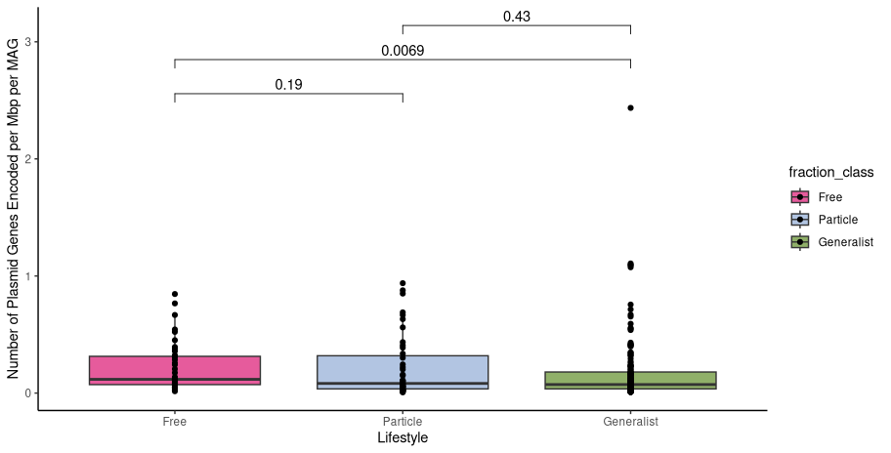
How does bacterial lifestyle impact the number of plasmid encoded genes?
Notes:
Explain the axis first
Change the y axis to be divded by MAG
Start with white box, explain the axis, explain the methods, then explain results
Then add concise sentence for conclusion (
Do geom_point to show the points (outlier.shape = FALSE)
Can do a bee swarm plot

Slide 54
How does bacterial lifestyle impact the number of plasmid-encoded genes?
There is a significant difference between free and generalist lifestyles
Notes:
or say free median is higher than generalist

Slide 55
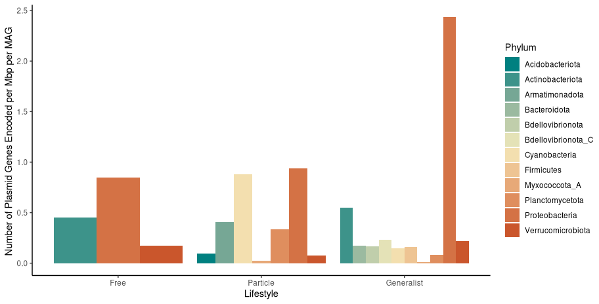
How does the number of plasmid-encoded genes vary by taxonomy?
Notes:
In the future just plot proteobacteria and verrucomicrobiota

Slide 56
How does the number of plasmid-encoded genes vary by taxonomy?
Notes:
In the future just plot proteobacteria and verrucomicrobiota

Slide 57
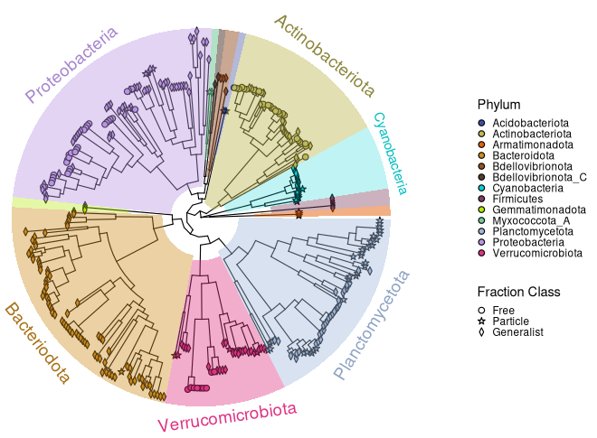

Slide 58
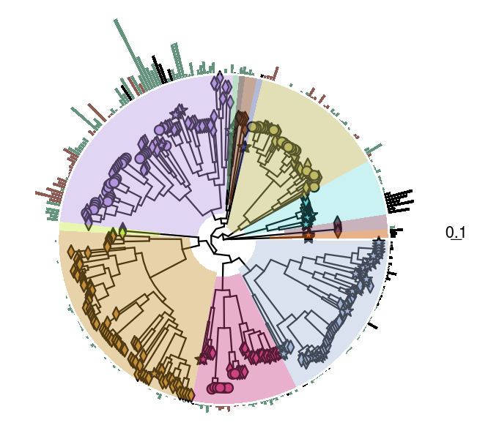
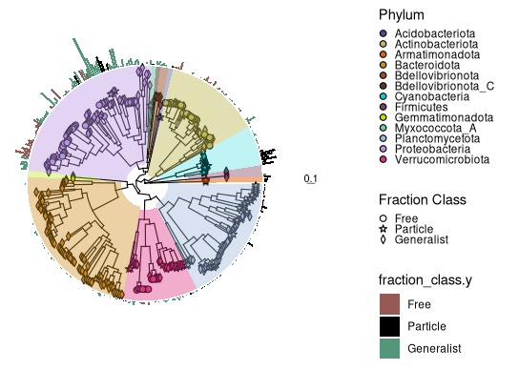
Plasmid-encoded genes have a strong phylogenetic signal suggesting influence by evolutionary relationships among species Plasmid-encoded genes are less variable under Brownian Motion due to conservatism in evolution
Pagel’s Lambda: 0.741024
(p-value = 3.056e-45)
Bloomberg’s K : 0.00532172
(p-value: 0.002002)
(based on 999 randomizations)
Notes:
Pagels: The trait of having conjugation genes are strongly dependent on phylogenetic relationships indicating a strong phylogenetic signal.
Bloomberg’s K: Conjugation genes are less variable under BM due to conservatism or constraints in evolution

Slide 59
Is there a difference in conjugation gene abundance between lifestyles? Hypothesis: There are more conjugation genes in particle-attached or generalist lifestyles because of the cell-to-cell contact

Slide 60
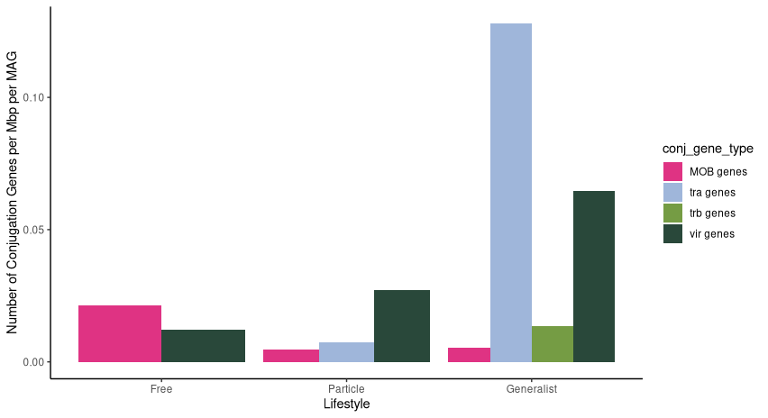
How do conjugation genes vary between lifestyle?

Slide 61
How do conjugation genes vary between lifestyle?
MOB and vir genes found in all lifestyles
Tra genes are only found in particle and generalist fractions

Slide 62
How do conjugation genes vary between lifestyle?
Assembly View
MAG View

Slide 63
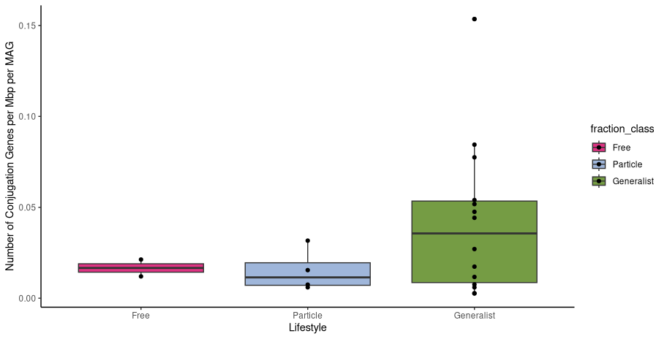
How do conjugation genes vary between lifestyle?

Slide 64
How do conjugation genes vary between lifestyle?

Slide 66
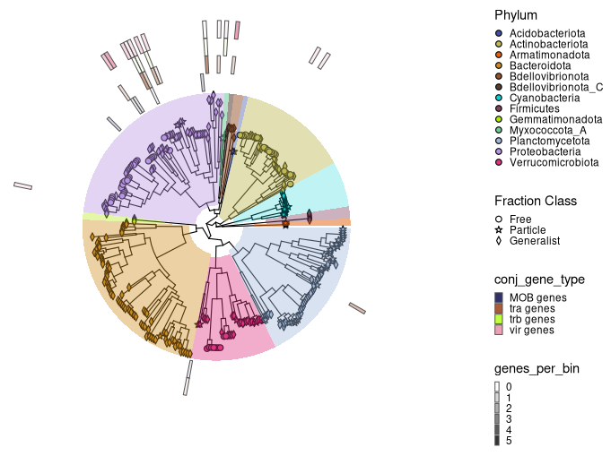
Conjugation genes are strongly dependent on phylogenetic relationships Conjugation genes are less variable under Brownian Motion due to conservatism in evolution
Pagel’s Lambda: 0.992932
(p-value = 3.56436e-54)
Bloomberg’s K : 0.0326016
(p-value : 0.001001)
(based on 999 randomizations)
Notes:
Pagels: The trait of having conjugation genes are strongly dependent on phylogenetic relationships indicating a strong phylogenetic signal.
Bloomberg’s K: Conjugation genes are less variable under BM due to conservatism or constraints in evolution

Slide 67
Is there a difference in phage-encoded gene abundance between lifestyles? Hypothesis: There are more phage-encoded genes in particle-attached or generalist lifestyles because of cell-to-cell contact

Slide 68
Is there a difference in phage-encoded gene abundance between lifestyles? Hypothesis: There are more phage-encoded genes in particle-attached or generalist lifestyles because of cell-to-cell contact

Slide 69
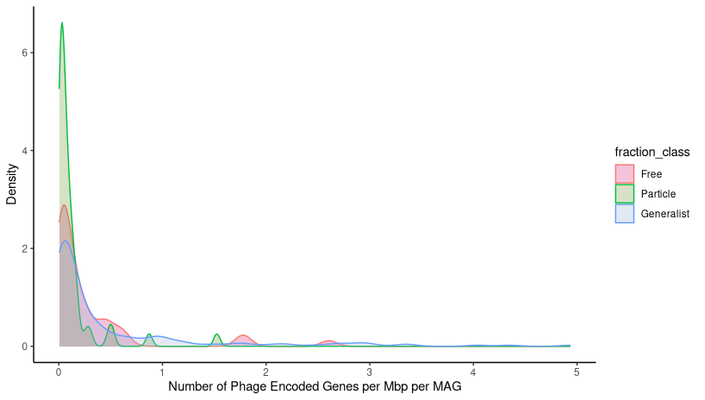
How does bacterial lifestyle impact the number of phage-encoded genes?

Slide 70
How does bacterial lifestyle impact the number of phage-encoded genes?

Slide 71
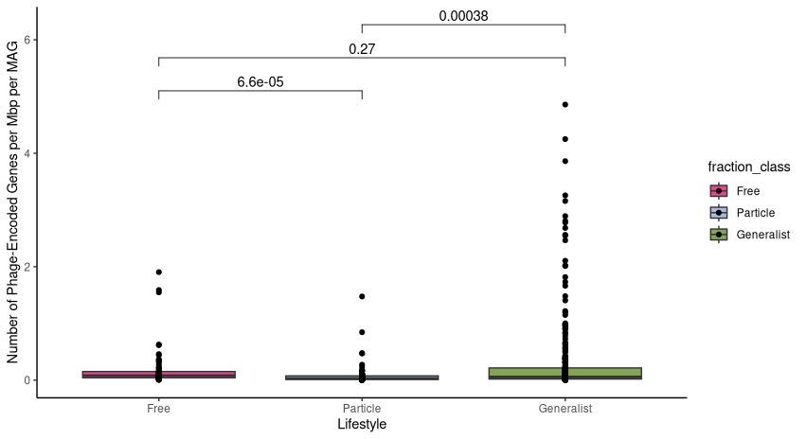
How does bacterial lifestyle impact the number of phage-encoded genes?

Slide 72
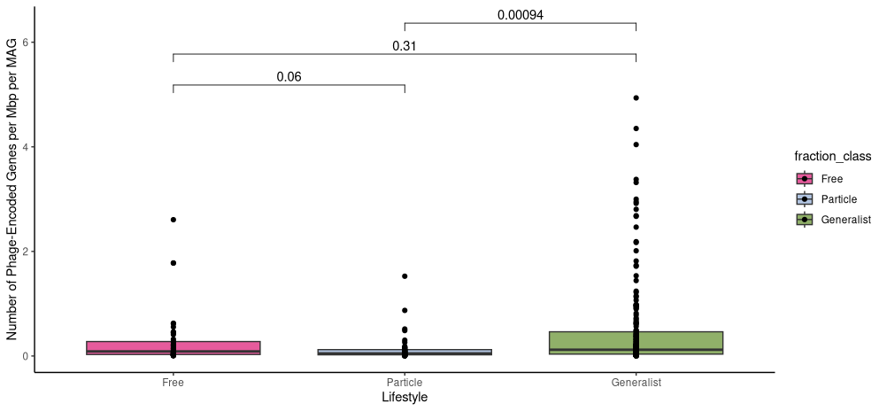
How does bacterial lifestyle impact the number of phage-encoded genes?
There is a significant difference between particle and generalist lifestyles
Generalist microbes have the highest amount of phage-encoded genes per MAG

Slide 73
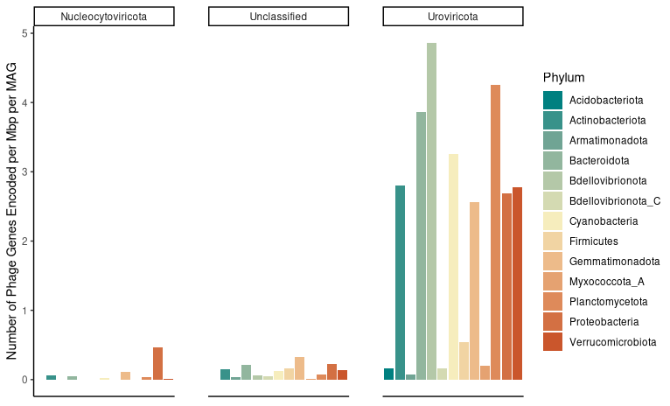
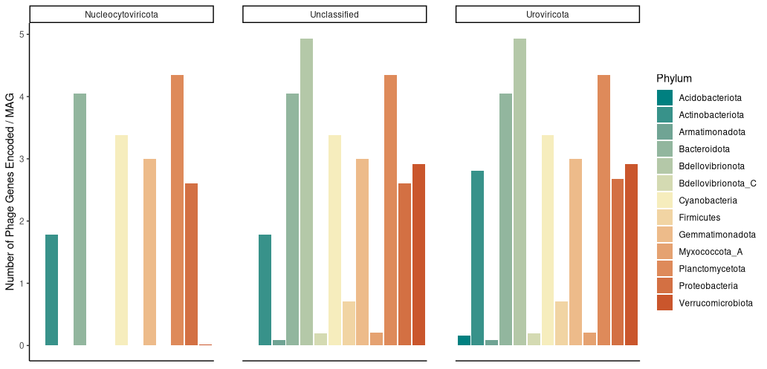
What are the most prevalent phylum of phages in each bacterial phylum?

Slide 74
What are the most prevalent phylum of phages in each bacterial phylum?
*Graphs of one phage in one phylum were removed*

Slide 75
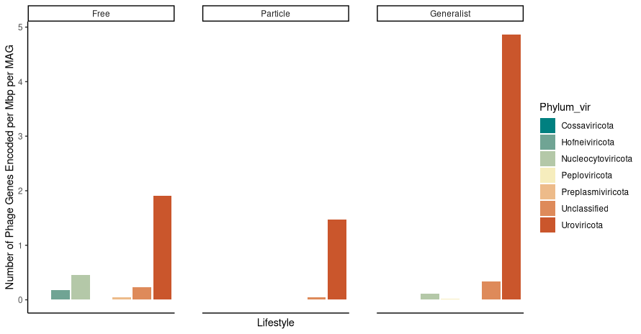
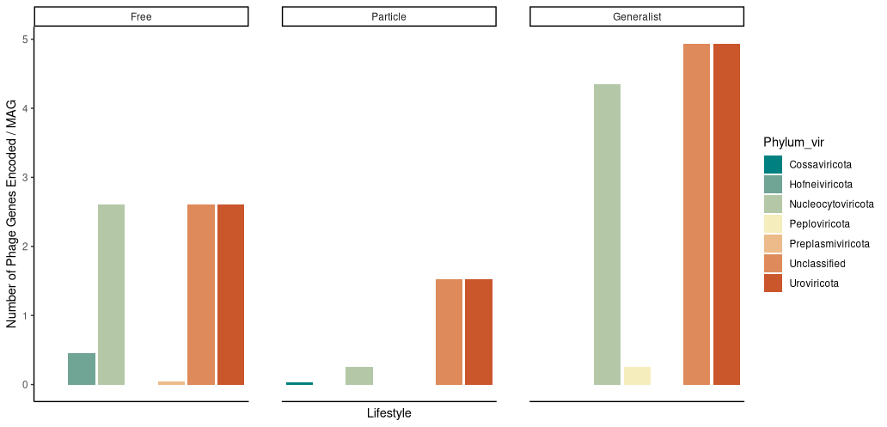
What phage-encoded genes are found in each lifestyle?

Slide 76
What phage-encoded genes are found in each lifestyle?

Slide 78
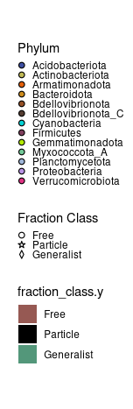
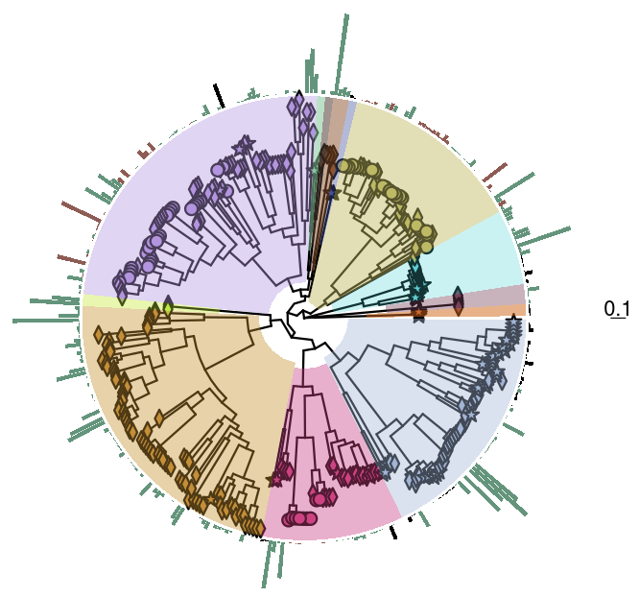
Phage-encoded genes have relatively low phylogenetic signal Phage-encoded genes are much less variable under Brownian Motion due to conservatism in evolution
Pagel’s Lambda: 0.242194
(p-value = 0.00922661)
Bloomberg’s K : 0.00182091
(p-value : 0.906907)
(based on 999 randomizations)
Notes:
Pagels: The trait of having phage encoded genes suggest relatively low phylogenetic signal. indicates that the observed trait of phage-encoded genes is less influenced by the evolutionary relationships among the species
Bloomberg’s K: phage encoded genes observed trait is extremely low, indicating that the trait is much less variable than expected under a Brownian Model which suggests a very strong conservatism or constraint in the evolution of phage-encoded genes.

Slide 79
Take Away Points

Slide 80

Mobile Genetic Elements are Ubiquitous in Nature
MGEs such as plasmids and phages play important roles in microbial evolution by providing fundamental sources of diversity
Horizontal gene transfer is largely mediated by MGEs

Slide 81
Our original hypothesis….
We hypothesized that particle-attached and/or generalist lifestyles would have higher rates of MGEs because of close proximity to each other
Yet, there are more free-living cells within a given community
Free-Living
Particle-Associated / Generalists?

Slide 82
Assembly Level View
We saw no significant difference in plasmid-encoded genes per Mb
Conjugation genes have similar distribution in both filter sizes

Slide 83
Assembly Level View
There is a significant difference in the number of phage-encoded genes per Mb which more found in the 0.22 um filter
Is it due to kill the winner hypothesis?

Slide 84
MAG Level View
We have 346 MAGs and majority of them were categorized as generalists (66%)

Slide 85
MAG Level View: Plasmids
In the free-living lifestyle, there is a higher median for plasmid-encoded genes than for generalists per Mb per MAG
Proteobacteria encodes the most plasmid-encoded genes which is seen in the generalist lifestyle
Database bias?
Conjugation genes vary between lifestyles
MOB and vir genes are found in each lifestyle
Tra genes have the highest abundance in the generalist lifestyle which corresponds to Proteobacteria abundance in the generalist lifestyle

Slide 86
MAG Level View: Plasmids
The observed trait of plasmid-encoded genes suggests that it is influenced by evolutionary relationships
The observed trait of conjugation genes is highly dependent on evolutionary relationships

Slide 87
MAG Level View: Phages
Generalist microbes have a higher amount of phage-encoded genes per Mbp per MAG
When looking at phage-encoded genes Uroviricota, Nucleocytoviricota, and Unclassified are the most prevalent
Uroviricota and unclassified phages infect all bacterial taxa in our data set
Uroviricota has the highest relative abundance in all lifestyles, particularly generalists

Slide 88
MAG Level View: Phages
The observed trait of phage-encoded genes has a relatively low phylogenetic signal indicating less influenced by evolutionary relationships

Slide 89
No antibiotic-resistance genes identified
Antibiotic resistance genes (ARGs) are commonly found on plasmids
Despite plasmid and phage abundances in both assembly and MAG levels, no ARGs were identified
Potentially ARGs are present on chromosomes
Or ARGs are not useful in this environment

Slide 90
Limitations
How we filter our samples introduces contamination
Free-living microbes need to pass through the 3.0 um to get to the 0.22 um filter
Likely they get stuck on the 3.0 um filter
Database limitations
We only know as much as we have cultured/ sequenced
What we know about plasmids is mainly from Proteobacteria like E. coli
Microbes use other MGEs to mobilize genetic material
We are still trying to understand these mechanisms

Slide 91
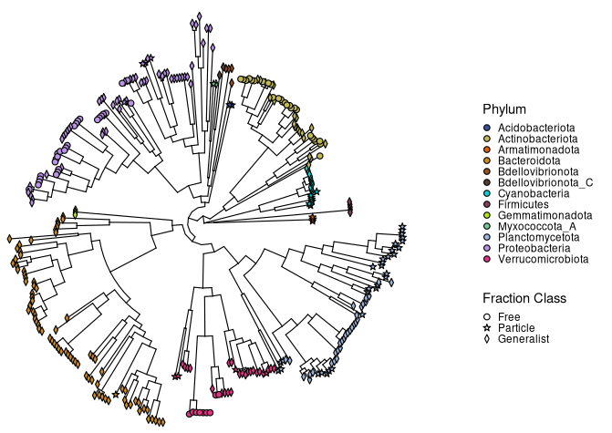
Phylogenetic Tree

Slide 92
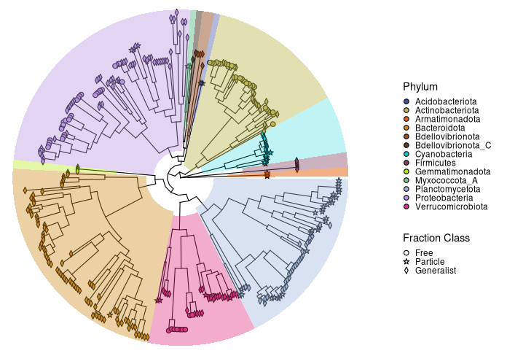
Phylogenetic Tree Highlight

Slide 93
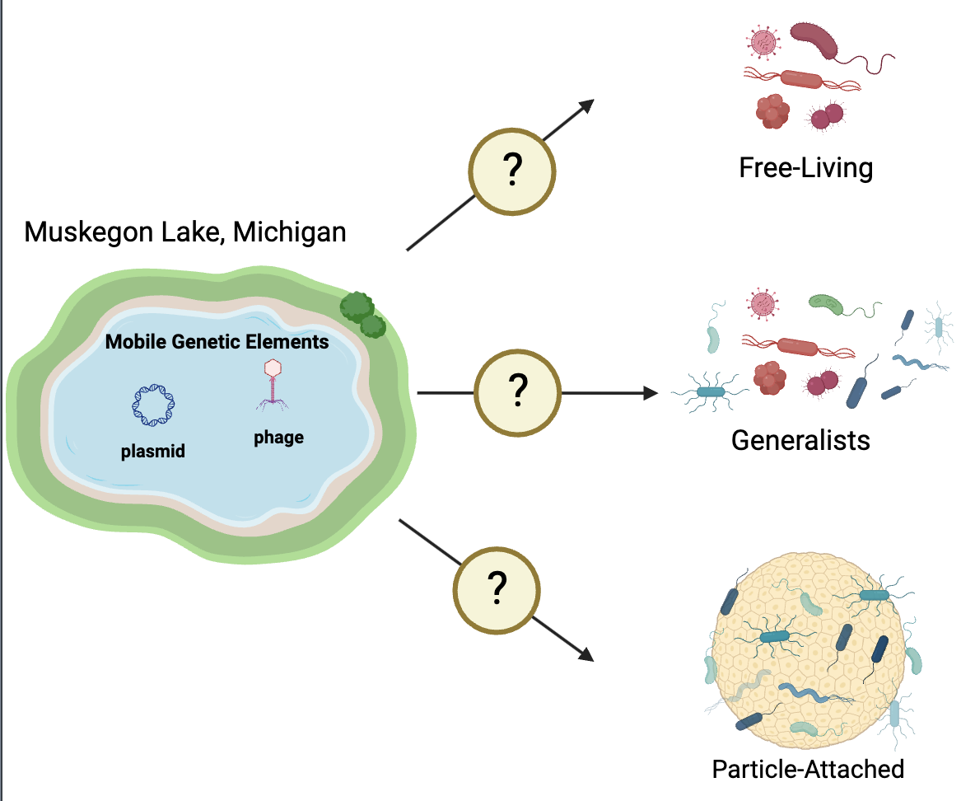
 | Metagenome Assembled Genome (MAG) Analysis |  | Community Contig Assembly Analysis
 | # Plasmid Genes | # Phage Genes | # Plasmid Genes | # Phage Genes
Free-Living
Generalists
Particle-Attached

